Slide 1
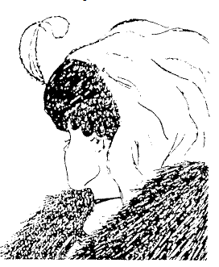

PERCEPTION
Perception is our awareness and understanding of the elements and objects of our environment through the physical sensation of our various senses, including sight, sound, smell, and so forth.
EXPERIENCE
Perception is influenced, in part, by experience. We classify stimuli based on models stored in our memories and in this way achieve understanding.
GESTALT PRINCIPLES OF PERCEPTION
CLOSURE
Our perception is synthetic; it establishes meaningful wholes. If something does not quite close itself, such as a circle, square, triangle, or word, we see it as closed anyway.
PROXIMITY
Our eyes and mind see objects as belonging together if they are near each other in space.

Slide 2

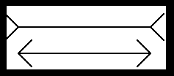
SIMILARITY
Our eyes and mind see objects as belonging together if they share a common visual property, such as color, size, shape, brightness, or orientation.
CONTINUITY
Shortened lines may be automatically extended.
EXPECTANCIES
Perception is also influenced by expectancies; sometimes we perceive not what is there but what we expect to be there. Missing a spelling mistake in proofreading something we write is often an example of a perceptual expectancy error; we see not how a word is spelled, but how we expect to see it spelled.
BALANCE
We desire stabilization or equilibrium in our viewing environment. Vertical, horizontal, and right angles are the most visually satisfying and easiest to look at.
CONTEXT

Slide 3
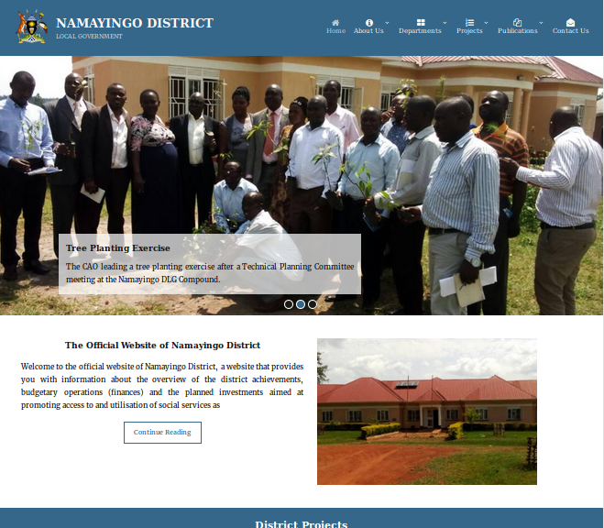
GESTALT PRINCIPLES APPLIED IN UI DESIGN
Proximity
Similarity
Symmetry
Closure
Figure-Ground
Among others…

